Slide 1
Data analysis and visualization (CS306)
Instructor: Manish Narwaria

Slide 2
Confidence intervals
another type of inferential statistic
multi-valued estimate (unlike a point estimate) of a population parameter (eg. mean, standard deviation, correlation coefficient…)
defines an interval of plausible values of a population parameter
related to hypothesis testing

Slide 3
Confidence intervals
CLT can be applied if the population parameter under consideration is the sample mean
to construct the CI for a population with mean and standard deviation

Slide 4
Confidence intervals

Slide 5
Confidence intervals
95% CI
can we use this in practice?

Slide 6
Confidence intervals
in practice, population variance is unknown

Slide 7
Confidence intervals
interpretation of a CI
what the meaning of 95% CI?

Slide 8
Confidence intervals
inferring statistical significance from CI for comparing population parameters
observe if the two CIs overlap

Slide 9
Confidence intervals
compute the upper and lower bounds for the two sample means separately
if the two CIs do not overlap then,

Slide 10
Confidence intervals
CI can also be determined for difference in means
what will be the condition for statistically significant difference?

Slide 11
Confidence intervals
compute the CIs for the sample means
no overlap --> the difference in means is statistically significant (will agree with t-test)
overlap --> the difference in means may or may not be statistically significant (t-test may or may not agree)

Slide 12
Confidence intervals
not significant
significant
CI overlap
no CI overlap

Slide 13
Confidence intervals
The operations manager of a large production plant would like to estimate the mean amount of time a worker takes to assemble a new electronic component. Assume that the standard deviation of this assembly time is 3.6 minutes.
after observing 120 workers assembling similar devices, the manager noticed that their average time was 16.2 minutes. Construct a 92% confidence interval for the mean assembly time.
how many workers should be involved in this study in order to have the mean assembly time estimated up to ±15 seconds with 92% confidence?

Slide 14
Confidence intervals
suppose the mean CPI value for a sample of 100 randomly selected students is 7.01 with standard deviation being 0.8.
construct a 95% CI for true population mean.
now compute a 100% CI for true population mean.
which of the two is more useful?
why not use say 40% CI?

Slide 15
Confidence intervals
Assumptions for Validity of Confidence Interval and Hypothesis test for μ
data must be from a random sample from large population
observations in the sample must be independent of each other
n small, population distribution must be approximately normal
n large, population need not be approximately normal (CLT kicks in)

Slide 16
Confidence intervals
few other not-so-correct statements:
if n > 30 then sampling distribution of mean is normally distributed
if n > 30, then normality can be assumed and
can be used
if n < 30, we should use

Slide 17
Confidence intervals
suppose there are 3 different populations: uniform, rayleigh and normal. We draw random samples of size 25 from each population. Further, by design, the samples are drawn such that they have same variances. Now we construct 95% CI for each sample mean.
in which case will the CI be shortest and why?
in which will the CI be more useful from a practical view point?

Slide 18
Confidence intervals
correlation: the degree to which two variables co-vary
quantifying the linear relationship of two variables
Pearson linear correlation coefficient: a popular measure of the intensity of linear association

Slide 19
Confidence intervals

Slide 20
Confidence intervals
scatter plot and correlation coefficient
2D plot with the two variables being the axes
data points will lie in a straight line if the correlation coefficient is high; otherwise scattered in the 2D space

Slide 21
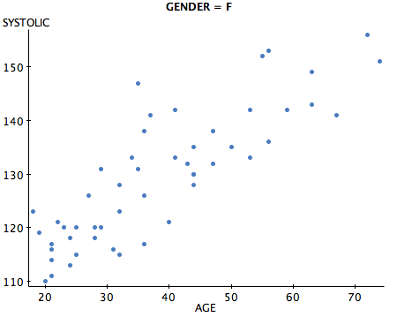
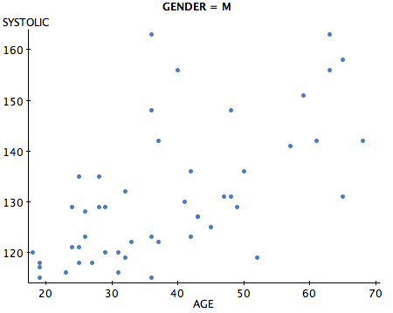
Confidence intervals
Image courtesy: http://www.statcrunch.com/

Slide 22
Confidence intervals
CI for correlation coefficient
why do we need to compute CI for r?
like mean, r is a descriptive statistic (widely used to quantify the degree of relationship in statistics, video processing, machine learning, social sciences, life sciences…)

Slide 23
Confidence intervals
r can also be used to measure the effect size for statistical tests
higher r implies more similarity --> difference of means is more likely to be practically not useful

Slide 24
Confidence intervals
CI for r
how can we compute CI for r ?
can we use the formulae for CI of mean to compute the CI for r ?
yes if sampling distribution of r follows normal distribution

Slide 25
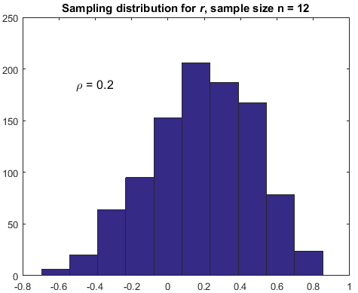
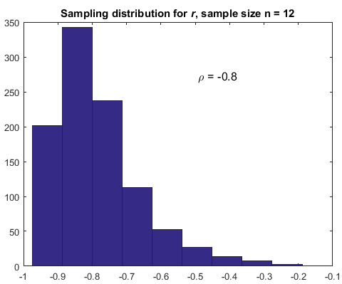
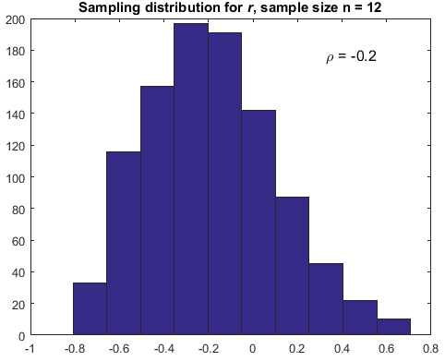
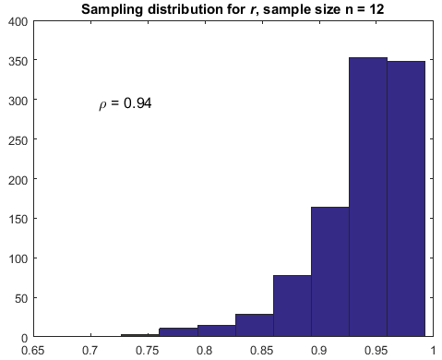
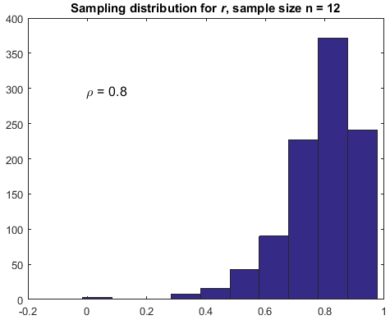
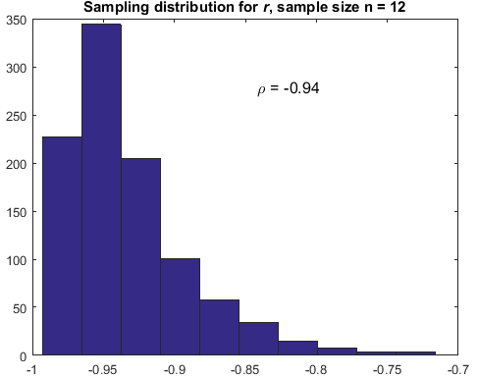
Confidence intervals
why is the sampling distribution skewed when the population correlation is increased?

Slide 26
Confidence intervals
CI for correlation coefficient
can we use the formulae for CI of mean to compute the CI for r ?
no (sampling distribution of r is skewed especially when the correlation between the two population is higher)

Slide 27
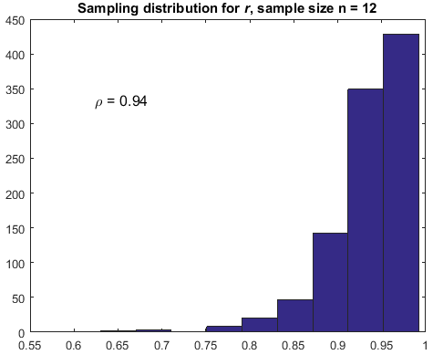
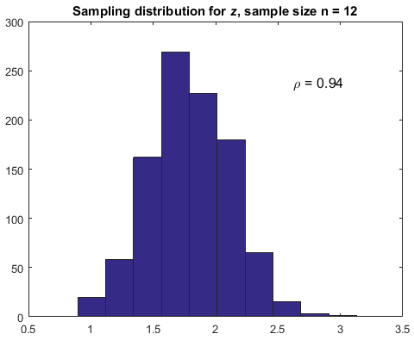
Confidence intervals
why is this useful?

Slide 28
Confidence intervals

Slide 29
Hypothesis testing
factor
mean
apriori distribution knowledge

Slide 30
Hypothesis testing
evaluate the effect of only one treatment factor (or variable) with one level
medicine A vs medicine B
3Mb full HD transmission vs 9Mb 720p transmission
paired t-test
subjective experiments --> fatigue factor
other factors can mask or inflate the actual effect

Slide 31
Hypothesis testing
if mean is not an accurate statistic for the sample --> inferences may be inaccurate (this is not a problem of the t-test)
recall: disadvantages of mean
less accurate for non-symmetric data (eg. lot of outliers)

Slide 32
Hypothesis testing
less accurate for non-symmetric data (eg. lot of outliers)
median is more robust to outliers
can we use CLT for median?
what about other test statistics (eg. ratio of mean and standard deviation)?

Slide 33
Hypothesis testing
what if we do not know how the sampling distribution of a test statistic behaves?
non-parametric tests
unlike parametric tests (t-test, f-test, z-test, anova…), do not need the knowledge of distribution parameters

Slide 34
Nonparametric testing
central idea to non-parametric testing: construction of a sampling distribution of the given test statistic
computationally intensive --> to match the continuous distribution

Slide 35
Nonparametric testing
how to construct sampling distribution of the test statistic?
idea of sampling the sample --> resampling
the importance of observed data --> whatever we know about the population is derived in the sample

Slide 36
Nonparametric testing
bootstrapping --> random sampling with replacement
permutation tests --> exchanging of data labels
cross-validation --> testing random subsets

Slide 37
Nonparametric testing
bootstrapping
generating a simulated sample (same size as observed sample) by drawing observations from observed sample independently and with replacement
useful in estimating standard error

Slide 38
Nonparametric testing
bootstrapping
for k = 1,2…N
sample with replacement
compute

Slide 39
Nonparametric testing
resampling (bootstrapping) is used to construct the sampling distribution of the given test statistic
a general method (applicable to any chosen test statistic including the mean)
constructed distribution can be used to draw inferences about the population

Slide 40
Nonparametric testing
CI based on resampling or the bootstrap percentile CI
recall that
end points of CI correspond to 2.5 and 97.5 percentiles of the sampling distribution of

Slide 41
Nonparametric testing
bootstrap percentile CI for median
median is of interest especially for skewed data
procedure: obtain bootstrapped samples and construct the sampling distribution of median
end points of CI correspond to 2.5 and 97.5 percentiles of this sampling distribution

Slide 42
Nonparametric testing
bootstrap percentile CI for median
eg. comparing median lifetime of batteries two brands, A (existing) and B (new)
for existing A, it is known that the median lifetime is 300 days
does the new battery brand B have higher median lifetime?

Slide 43
Nonparametric testing
bootstrap percentile CI for median
does the new battery brand B have higher median lifetime?
step 1: obtain a sample for the new battery brand B (case of irreversible sampling)

Slide 44
Nonparametric testing
sampling process:
batteries in the chosen sample should be independent
they were manufactured under same conditions
for inferential statistical analysis (parametric or nonparametric), the quality of sample is crucial

Slide 45
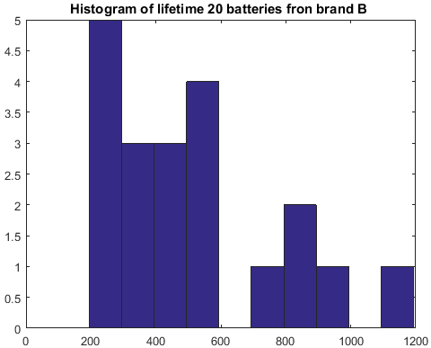
Nonparametric testing
196, 204, 233, 256, 258, 313, 315, 322, 403, 408, 483, 510, 538, 559, 586, 722, 806, 875, 930, 1192

Slide 46
Nonparametric testing
196,204,233,256,258,313,315,322,403,408,483,510,538,559,586,722,806,875,930,1192
sample median = 445.5 (> 300) but there are batteries with lifetime < 300
sample median is only an estimate of the population median

Slide 47
Nonparametric testing
goal: estimate by how much the sample median 445.5 misses the true population median (i.e. compute the CI)
construct the sampling distribution of the median battery lifetime --> resample the given sample with replacement (this ensures independence in resampling)

Slide 48
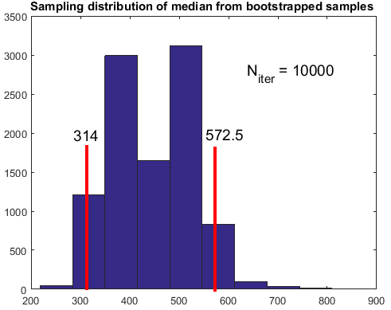
Nonparametric testing
CI for median: [314 572.5]
median lifetime for brand A
is 300
is brand B better in terms
of battery lifetime?

Slide 49
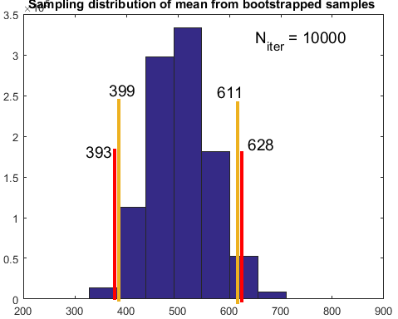
Nonparametric testing
will the difference
between bootstrapped and
theoretical CI matter?

Slide 50
Lab 8
see Results_Raw_Data_24obs.xls. It provides subjective quality scores for a set of 144 videos (each video is rated by 24 observers) and the MOS. The objective quality for these videos from two objective methods A and B are also provided in the file.
compute correlation CI etc. for comparison…
an objective score (either from method A or B) is deemed an outlier if it lies outside the confidence interval of the corresponding MOS

Slide 51
Lab 8
MOS PSNR SSIM

Slide 52
assignment 1
incorrect statements:
If n1 = n2 and the size of each sample is equal to or greater than 30, the t-test for independent groups may be used without appreciable error despite moderate violations of the normality and/or the homogeneity of variance assumptions
In the case of nonnormality, a nonparametric test or employing a transformation may result in a more powerful test

Slide 53
assignment 1
incorrect statements:
when the sample size is very large, and if we take repeated samples, the sample distribution will converge to a normal distribution irrespective of the distribution of the population
the sample normality is required for the t-test but the population normality is not required for t-test. The population should not be highly-skewed as well. This is because even if our distribution is not normally distributed, when the sample size is very very large, and if we take repeated samples, the sample distribution will converge to a normal distribution irrespective of the distribution of the population.

Slide 54
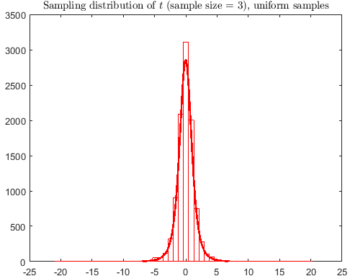
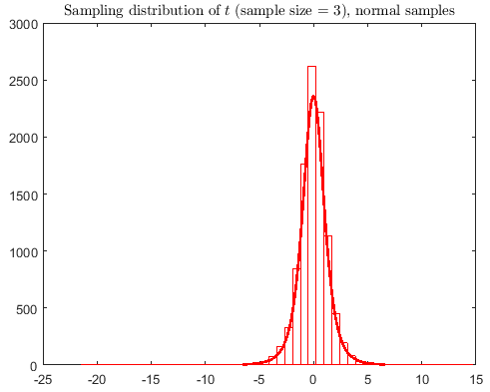
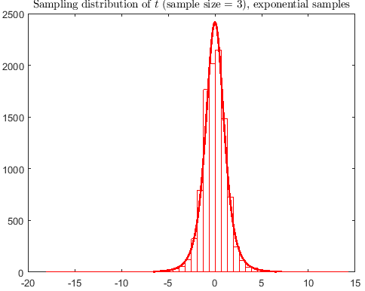
assignment 1

Slide 55
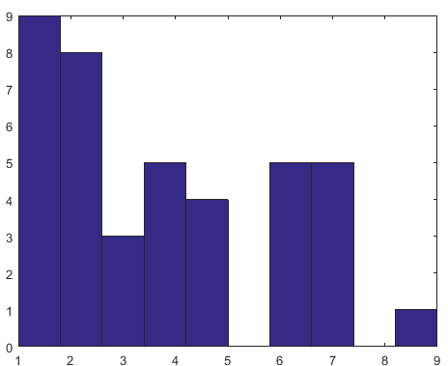
assignment 1

Slide 56
Nonparametric testing
which battery, X or Y, has higher lifetime?
X: 49, 53, 74, 111, 113, 335
Y: 62, 101, 167, 174, 190
can we employ t-test? sample normality? sample size?
should one always compare mean/median lifetimes?
can we employ instance based comparison and make inferences?
nonparametric tests enable such comparisons

Slide 57
Nonparametric testing
define a suitable test statistic --> Wilcoxon test statistic T
T : number of times an observation in one sample is bigger than those in second sample
allows comparison of each sample observation in the two samples

Slide 58
Nonparametric testing
Wilcoxon test statistic T
T is the number of matches between Y and X where Y is larger than X
what should be the null hypothesis?

Slide 59
Nonparametric testing
hypothesis testing based on resampling
comparing lifetimes of batteries of two brands
X: 49, 53, 74, 111, 113, 335
Y: 62, 101, 167, 174, 190
T = 20 (2+3+5+5+5)

Slide 60
Nonparametric testing
hypothesis testing based on resampling
comparing lifetimes of batteries of two brands
A: 49, 53, 74, 111, 113, 335
B: 62, 101, 167, 174, 190
total no. of comparisons =

Slide 61
Nonparametric testing
hypothesis testing based on resampling
T = 20, is it statistically large enough to reject null hypothesis?
we need to know the sampling distribution of T, assuming H₀ to be true (similar idea as parametric testing)

Slide 62
Nonparametric testing
hypothesis testing based on resampling
resample assuming H₀ to be true
combine the two samples into a larger one of size
the importance of H₀ in constructing sampling distribution

Slide 63
Nonparametric testing
the importance of H₀ in constructing sampling distribution
sampling distribution of t is constructed by drawing samples from same population
sampling distribution in JB test is constructed by drawing samples from same normal population
sampling distribution is always constructed assuming that there is no treatment effect
p-value is obtained because the null hypothesis is assumed true, so it should not be interpreted as the probability of null hypothesis being true or false

Slide 64
Nonparametric testing
hypothesis testing based on resampling
X: 49, 53, 74, 111, 113, 335
Y: 62, 101, 167, 174, 190
the null (combined) sample: 49, 53, 74, 111, 113, 335, 62, 101, 167, 174, 190

Slide 65
Nonparametric testing
hypothesis testing based on resampling
sample with replacement from the combined sample, randomly assigning of the values to be new X and values to be new Y

Slide 66
Nonparametric testing
hypothesis testing based on resampling
new X: 335, 167, 53, 335, 74, 62
new Y: 62, 49, 53, 174, 190
T = 10 (1.5 + 0 + 0.5 + 4 + 4)
notice repeated values in the two
new samples --> due to replacement

Slide 67
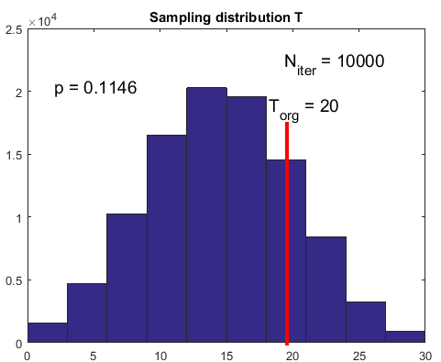
Nonparametric testing
locate the original T value
on the constructed
sampling distribution of T
insufficient evidence to
conclude if battery Y lasts
longer than X
by definition, T considers only positive difference
ignores the magnitude of difference (robust to outliers
or extreme values)

Slide 68
Nonparametric testing
hypothesis testing based on resampling
modified test statistic T considers both positive and negative differences
it is median of differences not difference of median

Slide 69
Nonparametric testing
hypothesis testing based on resampling
Y
 | 62 | 101 | 167 | 174 | 190
49 | 13 | 52 | 118 | 125 | 141
53 | 9 | 48 | 114 | 121 | 137
74 | -12 | 27 | 93 | 100 | 116
111 | -49 | -10 | 56 | 63 | 79
113 | -51 | -12 | 54 | 61 | 77
335 | -273 | -234 | -168 | -161 | -145
X

Slide 70
Nonparametric testing
hypothesis testing based on resampling
comparing lifetimes of batteries of two brands
X: 49, 53, 74, 111, 113, 335
Y: 62, 101, 167, 174, 190
modified test statistic T = 53 (original/observed test statistic)
is it statistically large enough to reject null hypothesis?

Slide 71
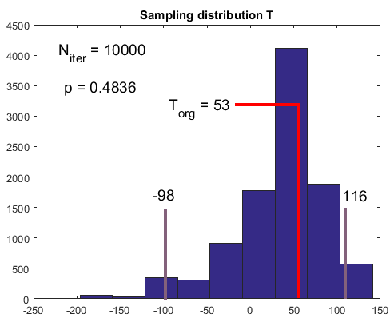
Nonparametric testing
what is the conclusion?
does it agree with previous resampling based testing?

Slide 72
Nonparametric testing
resampling/bootstrapping does not generate any new data
similar idea to parametric tests,
(SE comes from sample, not population)
can be used to estimate the variation
arises due to the selection of the original random sample from the population --> resampling by itself does not introduce variation

Slide 73
Nonparametric testing
hypothesis testing based on resampling
Wilcoxon is an intuitive statistic for general application of nonparametric testing
other test statistics can be used (difference in median, difference in mean…)
can we use arbitrary test statistic?

Slide 74
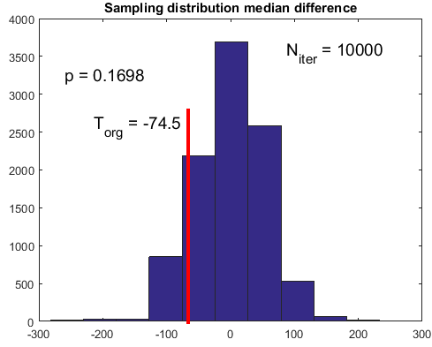
Nonparametric testing

Slide 75
Nonparametric testing
similarly we can find CI for difference in median, mean…
which test statistic to choose?
mean is less robust to outliers
Wilcoxon statistic is preferred due to its robustness (like median) and typically leads to smaller CI

Slide 76
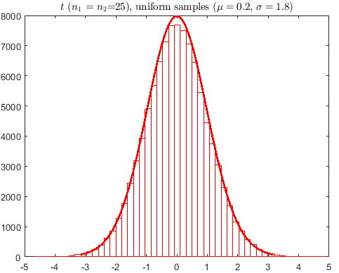
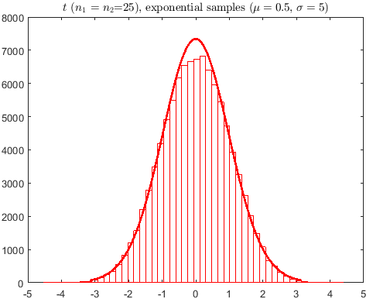
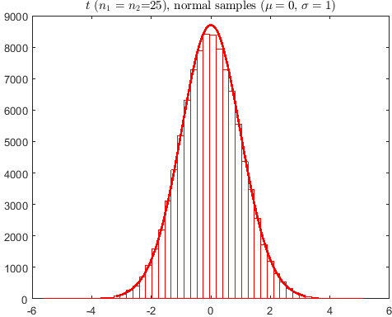
Assignment 1

Slide 77
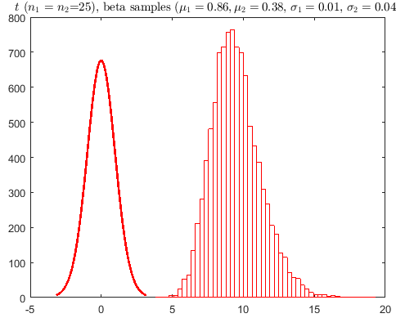
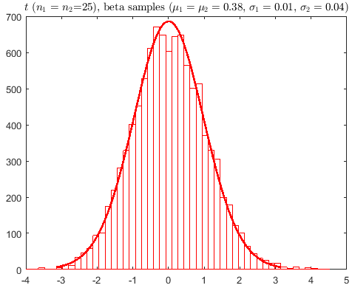
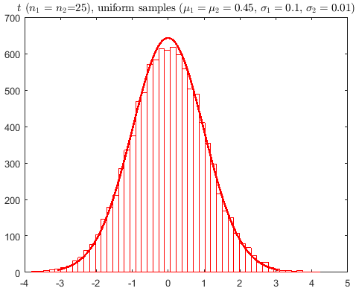
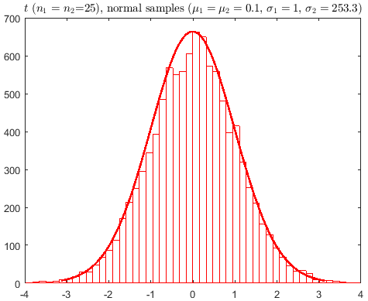
Assignment 1

Slide 78
Hypothesis testing

Slide 79
Hypothesis testing

Slide 80
Hypothesis testing

Slide 81
Hypothesis testing
for balanced design pooled t-test is better
more df as compared to unpooled version
in many practical cases, different population variance can imply errors or wrong measurements

Slide 82
Hypothesis testing
collect data --> conduct statistical inference test --> accept or reject null --> state the conclusions
did any other factor mask or inflate the actual effect
effect size not just p-values

